Slide 1
Contact:
shlomi.gian@gmail.com
daniel.lipkin@gmail.com

Slide 2
The Enterprise Challenge
As enterprises adopt cloud services, consolidating, analyzing and sharing data becomes hard to impossible.

Slide 3
More specifically…
Managers constantly navigate between services to see related data.
Each department has its business view.
Managers rely on other team members for data they do not have access to.
It is difficult to correlate data from different sources.
It is hard to share data and collaborate with others.
The problem is worse “on the go”.

Slide 4

What is “Just the Facts”?
A dashboard of dashboards that brings key facts from enterprise cloud services together in one place.

Slide 5

How is it different?
Easy to setup.
Self service.
Built for collaboration.
Low monthly subscription.

Slide 6
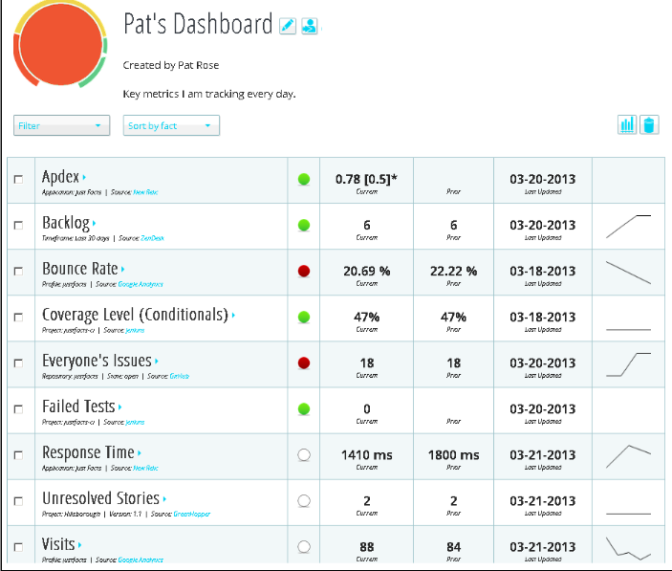
Just the Facts Dashboard
Monitor Targets
Track Comments
Share with Team

Slide 7

Benefits
Productivity
Communication
Decision Making

Slide 8
Backup

Slide 9








Competitive Landscape
Visualization
Cloud Connectors
Business Intelligence

Slide 10
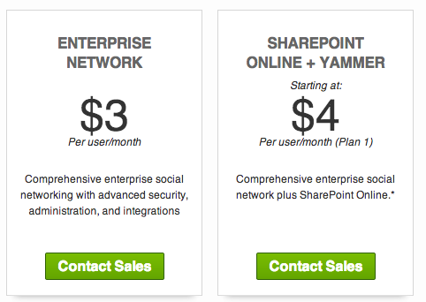
Business Model

Slide 11


The Team
CTO
CEO
Hands-on, full-stack technologist
Expertise in enterprise, cloud and social technologies
Leadership of engineering and architecture teams of various sizes
General Management
Strategic Alliances
Sales Management
Business Development
Product Management

